Slide 1
SDLC & HDLC

Slide 2
Synchronous Data Link Communication (SDLC)
Synchronous Bit Oriented Protocol by IBM.(continuous stream of bits)
Simplex/half duplex/full duplex.
Sliding window protocol.
Language EBCDIC.
Data frame 256 characters long.
All data link control functions performed by a single control field.
Master-slave environment only.

Slide 3
The primary station controls data exchange on the communication channel and issues command.
The secondary station receives commands and returns responses to the primary.
Three transmission states:-
  Transient state:-before and after the initial transmission and after each line turnaround.
  Idle state:- after 15 or more consecutive 1s have been received.
  Active state:- whenever either primary or secondary station is transmitting information or control signals.

Slide 4
General frame structure:
Flag | Address | Control | Data… | FCS | Flag
8 bits | 8 bits | 8 bits | Variable multiples of 8 | 16 bits | 8 bits

Slide 5
Each SDLC frame consists of the following fields:
1. Flag Field
Marks the beginning and end of a frame
Helps detect frame boundaries and synchronization
2. Address Field
Identifies the secondary station involved
Supports individual, group, and broadcast addressing

Slide 6
3. Control Field
Defines the function and type of the frame
Supports three formats:
  Unnumbered (U) Frame: Link setup, disconnection, and control functions
  Supervisory (S) Frame: Acknowledgments, flow control, and error reporting
  Information (I) Frame: Data transfer and sequence control

Slide 7
4. Information/Data Field
  Optional field containing user data to be transmitted
5. Frame Check Sequence (FCS)
  Used for error detection
  Ensures the integrity of the received frame
6. Ending Flag Field
  Indicates the end of the transmission frame

Slide 8
Purpose of an SDLC Frame
An SDLC frame enables the receiving station to:
  Identify the start and end of a frame
  Determine whether the frame is intended for it
  Understand what action to perform on the received data
  Detect transmission errors
  Acknowledge successful frame reception

Slide 9
High-level Data Link Control HDLC
HDLC is a discipline for the management of information transfer over a data communication channel
HDLC has a basic structure that governs the function and the use of control procedures. The basic structure includes:
  The definitions of primary and secondary station responsibilities.
  The design of information grouping for control and checking.
  The design of the format for transfer of information and control data.

Slide 10
Primary and secondary stations
A data link involves two or more participating stations. For control purposes one station on the link is designated a primary station, the others are secondary stations.
The primary station is responsible for the organisation of data flow and for the link level error recovery procedures.
A frame sent from a primary station is referred to as a command frame. A frame from a secondary to a primary is referred to as a response frame.
Normally when a command is sent, a response or a string of responses is expected in reply

Slide 11
HDLC Station Types
Primary station
  Controls operation of link
  Issues commands (frames)
  Maintains separate logical link to each secondary station
Secondary station
  Under control of primary station
  Issues responses (frames)
Combined station
  May issue commands and responses
  Combines the features of primary and secondary stations

Slide 12
HDLC Link Configurations
Unbalanced
  One primary and one or more secondary stations
  Supports full duplex and half duplex
Balanced
  Two combined stations
  Supports full duplex and half duplex

Slide 13
Frame Structure
Synchronous transmission
All transmissions in frames
Single frame format for all data and control exchanges

Slide 14
Types of frames
There are three kinds of frames:
I-frame: Information frame: This type of frame carries user’s data.
S-frame: Supervisory frame: used for error and flow control.
  This is used for supervisory control functions such as acknowledgements, requesting transmission and requesting a temporary suspension of transmission.
U-frame: Unnumbered frame or Unsequenced frame:
  Unnumbered frames are used for link management. This is used to provide additional link control functions.
  Used to set up the logical link between the primary station and a secondary station
  To inform the secondary station about the mode of operation which is used.

Slide 15
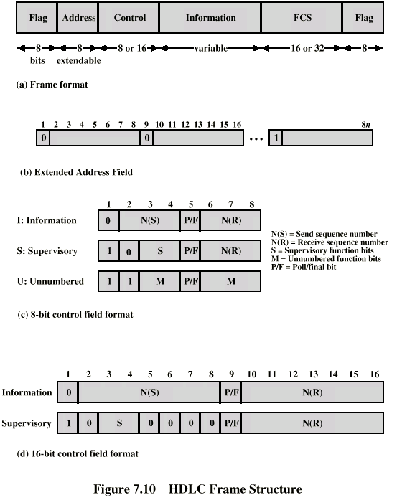
Frame Structure
Defines 3 types of frames (I,S,U frames)
01111110
01111110

Slide 16
Flag Fields
Delimit frame at both ends
01111110
Receiver hunts for flag sequence to synchronize
Bit stuffing used to avoid confusion with data containing 01111110
  The transmitter inserts 0 bit after every sequence of five 1s with the exception of flag fields
  If receiver detects five 1s it checks next bit
    If 0, it is deleted
    If 1 and seventh bit is 0 (i.e., 10), accept as flag
    If sixth and seventh bits 1 (i.e., 11), sender is indicating abort

Slide 17
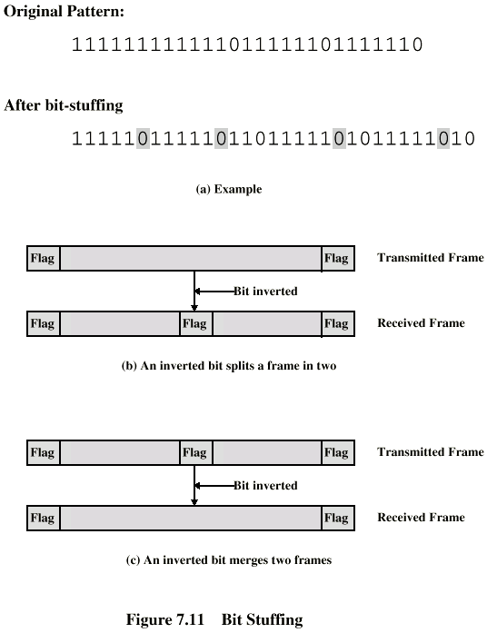
Bit Stuffing
Example with
possible errors

Slide 18
Address Field
Identifies secondary station that sent or will receive frame
Usually 8 bits long
May be extended to multiples of 7 bits
  LSB of each octet indicates that it is the last octet (1) or not (0)
All ones (11111111) is broadcast

Slide 19
Control Field
Different for different frame type
  I-frame (information frame)
    data to be transmitted to user (next layer up)
    Flow and error control piggybacked on information frames
  S-frame (Supervisory frame)
    Used for flow and error control
  U-frame (Unnumbered frame)
    supplementary link control
First one or two bits of control filed identify frame type

Slide 20
Control Field Diagram

Slide 21
Poll/Final Bit
Use depends on context
Command frame
  P bit : used for poll from primary
  1 to solicit (poll) response from peer
Response frame
  F bit : used for response from secondary
  1 indicates response to soliciting command

Slide 22
I-frame
Contains the sequence number of transmitted frames and a piggybacked ACK
1 2 3 4 5 6 7 8
0
N(S)
P/F
N(R)
I,0,0
I,1,0
I,2,0,P

Slide 23
S-frame
Used for flow and error control
1 2 3 4 5 6 7 8
1
0
S
P/F
N(R)
RR --- receive ready
RNR --- receive not ready
REJ --- reject on frame N(R)
SREJ --- selective reject on N(R)

Slide 24
U-frame
Mode setting, recovery, connect/diconnect
1 2 3 4 5 6 7 8
1
1
M
P/F
M
Unnumbered function bits

Slide 25
Unnumberred frames
Set normal response mode (SNRM)
Set asynchronous response mode (SARM)
Set asynchronous balanced mode (SABM)
Disconnect (DISC)
Unnumberred acknowledgement (UA)
Disconnect mode (DM)
Request disconnect (RD)
Unnumberred poll (UP)
Reset (RSET)
Exchange identification (XID)
Test (TEST)
Frame reject (FRMR)

Slide 26
Information Field
Only in information and some unnumbered frames
Must contain integral number of octets
Variable length

Slide 27
Frame Check Sequence Field
FCS
Error detection
16 bit CRC
Optional 32 bit CRC

Slide 28
Data link channel states
Active channel state:
A channel is in an ACTIVE state when the primary or a secondary is actively transmitting a frame, a single abort sequence or interframe time fill. In this state the right to continue transmission is reserved.
Abort:
A station can abort a frame by transmitting at least seven contiguous ones. The receiving station will ignore the frame.
Interframe time fill:
In this state continuous flag bytes are sent between frames.
Idle channel state:
A channel is defined to be in an IDLE state when the transmission of 15 or more contiguous one bits is detected. In this state a primary must repoll a secondary before transmitting an I-frame to it.

Slide 29
Modes of operation
Normal response mode
  In this mode a secondary station can transmit only in response to a command frame from the primary station.
  The response transmission may consist of one or more frames, the last of which must be explicitly indicated (using the Poll/Final bit).
  The secondary then cannot transmit again until it receives another command to do so.

Slide 30
Asynchronous Response Mode (ARM)
  In this mode the secondary station may initiate transmission of a frame or group of frames without receiving explicit permission from the primary.
  The frames may contain data or control information.
  The secondary station is responsible for time-out and retransmission if necessary.
Asynchronous Balanced Mode (ABM)
  In this mode the stations have identical protocols. They both can initiate transmission at any time.
  They can send both commands and responses.

Slide 31
HDLC Operation
Exchange of information, supervisory and unnumbered frames
Three phases
  Initialization
  Data transfer
  Disconnect

Slide 32
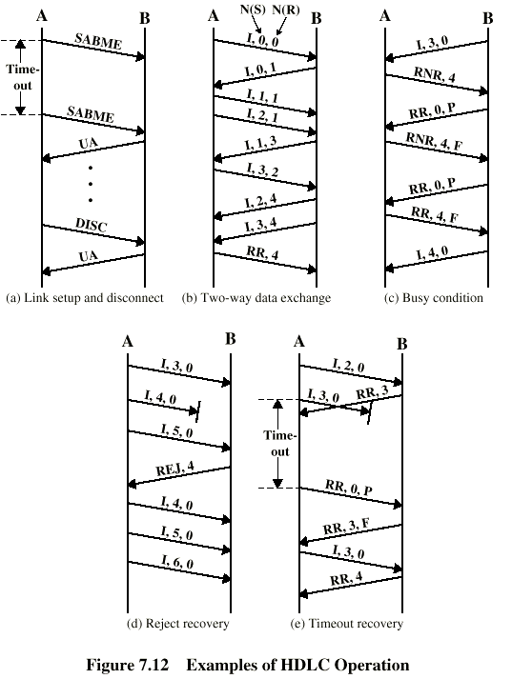
Examples of Operation (1)

Slide 33
Examples of Operation (2)

